Slide 1
Mining Insights from Cancer-Related Discussions: A Text Analysis Approach

Slide 2
Problem Statement and Goals
Problem Statement: To extract key insights from unstructured text data within cancer-related online forums and discussions.
Goals:
To analyze the sentiment and emotional tone behind discussions.
To identify prevalent topics and how they align with patient concerns.
To observe trend shifts over time indicating changes in public awareness.
To perform a comparative analysis across different cancer types.

Slide 3
Data Source and Quality
Data Source:
User-generated content from online health forums and platforms like Reddit.
Data Quality:
Rich textual data containing real-world patient experiences and opinions.
The high volume of data ensures a wide range of discussions.
Potential for missing data or non-standard language usage as a consideration.

Slide 4
Tasks
Sentiment Analysis
To categorize the sentiment of discussions as positive, negative, or neutral by employing the TF-IDF vectorization method or BERT embeddings for text representation, and then using Support Vector Machines (SVM) or the BERT model for the classification task.
Topic Modeling
We leverage SBERT for semantic embeddings and k-means for preliminary clustering. BerTopic then refines these topics, offering detailed insights.
Trend Analysis
Trend analysis helps in understanding how the popularity of topics changes over time.
Detect emerging discussions around new treatments or changes in community concerns.
Comparative Analysis
To compare the volume and nature of discussions across different types of cancer.
Quantitative analysis of topic occurrence and sentiment across cancer types.
Insights to guide healthcare providers in resource allocation and support services.

Slide 5
Technical Challenges
Data Handling: Managing large datasets with potential performance issues during processing.
Text Preprocessing: Complexities in cleaning and preparing user-generated content for analysis.
Model Selection: Choosing the right model parameters and validating the model's predictive capabilities.

Slide 6
Ethical Considerations
Privacy: Ensuring that individual user information is anonymized.
Consent: Using publicly available data while respecting platform terms of service.
Bias: Mitigating the risk of algorithmic bias that can skew the analysis results.

Slide 7
About Data and Modelling

Slide 8
About Data
We are analyzing testicular Cancer Data which consist of 38K rows and 15 columns where as brain Cancer data consist of 10K rows
Title,
Date of Creation
(Year, Month, Day)
Author
Post Characteristics (is_self, over_18),
Engagement (num_comments),
IDs (id_x, subreddit_id_x),
author
parent_id
body, link_id

Slide 9
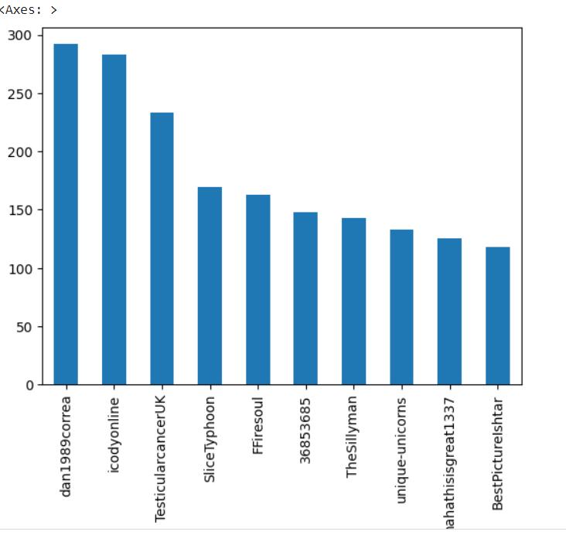
Basic Analysis
Authors with most contribution to cancers posts.

Slide 10
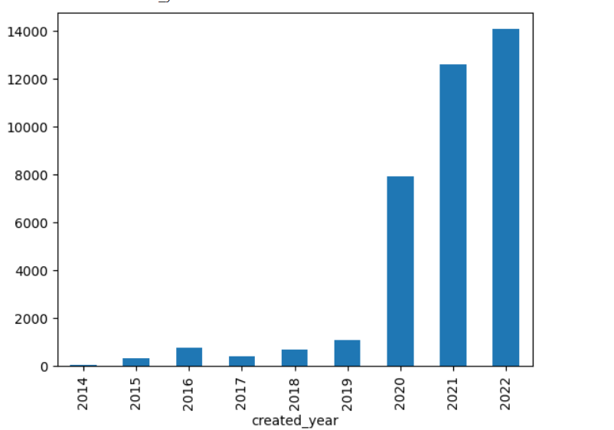
Number of Post from each Year

Slide 11
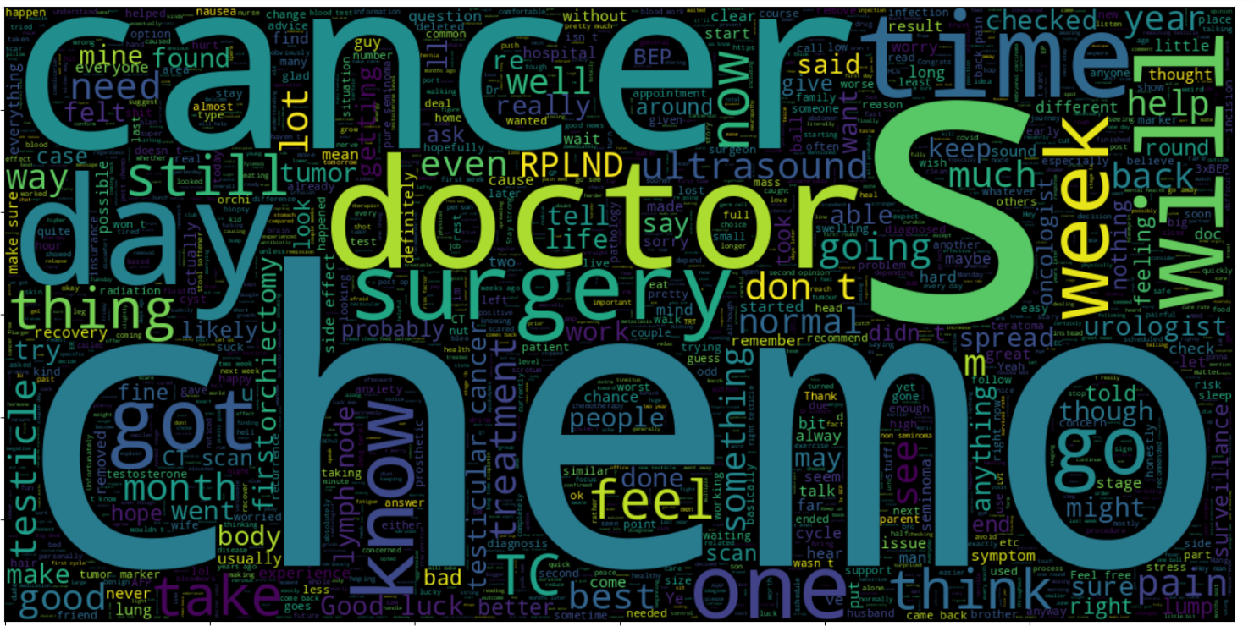
WordCloud of uncleaned Data

Slide 12
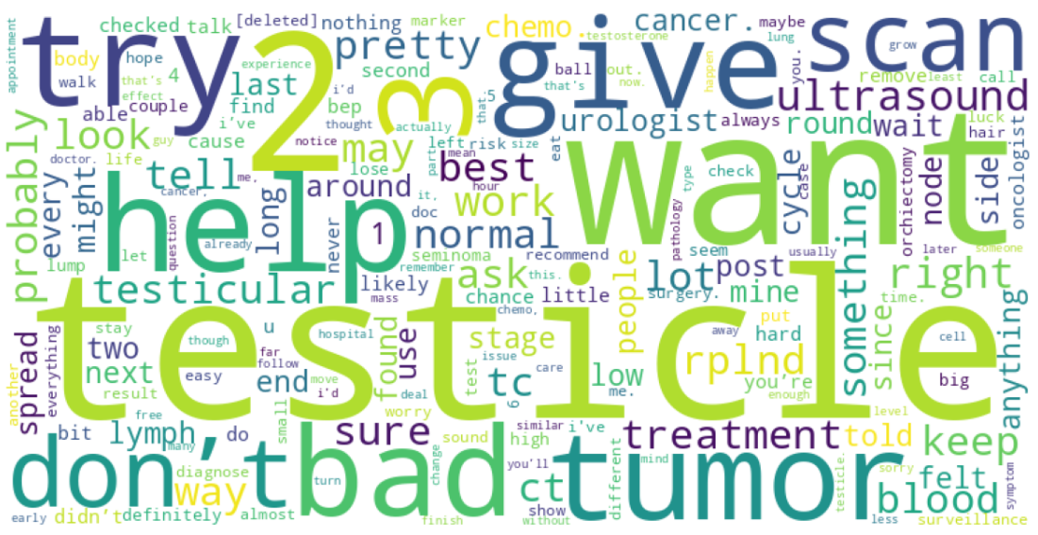
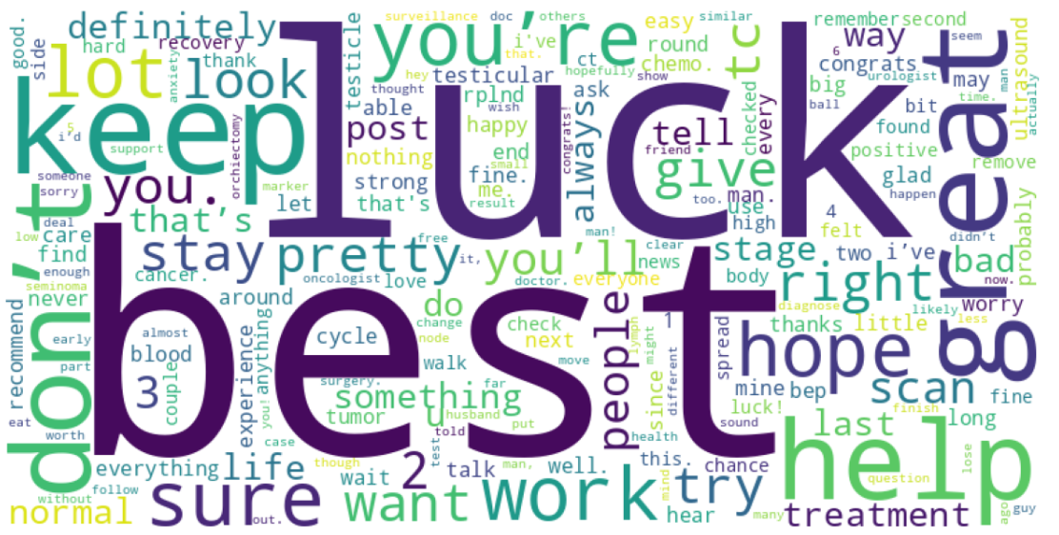
Wordcloud for positive and Negative sentiment
Negative Sentiment data
Positive Sentiment data

Slide 13
Data Cleaning Steps
Removal of Stop words
Removal of non-alphabets
Lemmatization
Lowercase
Tokenization

Slide 14
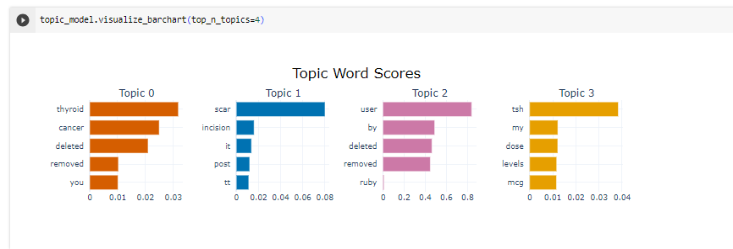
Topic Modelling on Brain Cancer data BertTopic

Slide 15

Future Updates
More cleaning of data
Topic Modelling on Testicular Cancer data
More analyzing

